Slide 1
Location Recommender System: Choosing the Best Neighborhood to Start Your Business in a Large City
Capstone Project by Maryam Rahafrooz

Slide 2
Project Objective
Create a platform to inform investors, and business decision makers on suitable neighborhoods for their business, based on the number of competitors and the potential demand in each neighborhood.

Slide 3
Data sources for this project
Scraped Zumper for the average rent (1bed apt) in all neighborhoods of 25 large cities across the US (1,662 neighborhoods) (https://www.zumper.com/rent-research)
Extracted Geolocation of the neighborhoods ( use Geopy)
Used Foursquare API to get number and type of venues around these neighborhoods

Slide 4
Methodology
Select neighborhoods with fewer competitors
Cluster the neighborhoods based on the type and frequency of their nearby venues
Sort the neighborhoods in each cluster based on their average renting price

Slide 5
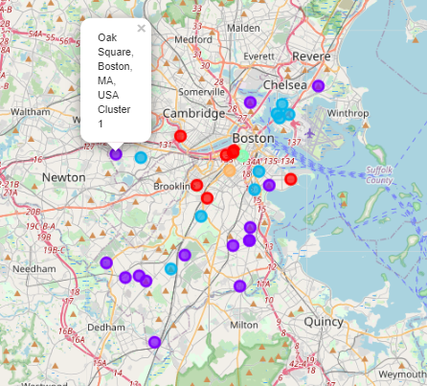
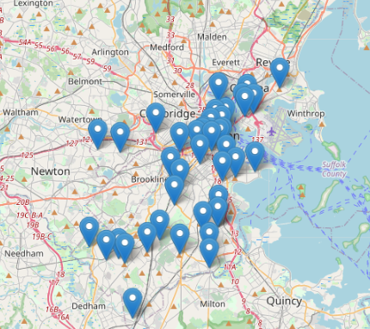
Example: Ice-cream shop in Boston
Business of interest: Ice-Cream shop
competitors: Ice-Cream, Frozen Yogurt
Radius (m): 500
Location(s) of interest: Boston
Venues: Park, Recreation Center, Playground ,...
You are investigating 43 neighborhoods of Boston

Slide 6
The script used to generate the results:
https://nbviewer.jupyter.org/github/maryraha/TDI/blob/main/Sec1.ipynb

